Slide 1

Welcome to Sabbath School
Illustration by Jo Card. Copyright © 2024 General Conference Corporation® of Seventh-day Adventists.

Slide 2

EARLY ARRIVALS
EARLY
ARRIVALS

Slide 3
Welcome to Sabbath School
Illustration by Jo Card. Copyright © 2024 General Conference Corporation® of Seventh-day Adventists.

Slide 4


Be Happy
OPENING ACTIVITIES
Wake up in the morning
At the start of the day.
What will you be facing?
What’s gonna come your way?
There’s always
Things that are out of your control
And challenges for you.
You can’t always choose your circumstance,
But You can choose your attitude.
(Continued on next slide)

Slide 5
Be Happy
OPENING ACTIVITIES
So, I’m gonna choose to be happy.
I’m gonna choose to be glad.
With a skip in my step
And a smile on my face
I choose to be happy today.
(Repeat above)
(Continued on next slide)

Slide 6
Be Happy
OPENING ACTIVITIES
Wake up in the morning
At the start of the day.
What will you be facing?
What’s gonna come your way?
There’s always
Things that are out of your control
And challenges for you.
You can’t always choose your circumstance,
But You can choose your attitude.
(Continued on next slide)

Slide 7
Be Happy
OPENING ACTIVITIES
So, I’m gonna choose to be happy.
I’m gonna choose to be glad.
With a skip in my step
And a smile on my face
I choose to be happy today.
(Repeat above)
"Be Happy" by Kimberly Houliston, copyright © 2004 Abide Family Ministries. Used by permission.

Slide 8
A Priceless Treasure
OPENING ACTIVITIES
God’s Word is (God’s Word is)
A priceless treasure.
Its worth is (Its worth is)
Far beyond measure.
Ev’ry page
Whispers the name
Of Jesus, Jesus.
(Repeat above)
Jesus
"A Priceless Treasure" by Rosie Smith, copyright © 2025 General Conference Corporation® of Seventh-day Adventists.

Slide 9
Be Still, Be Silent
OPENING ACTIVITIES
Be still, be silent
As we talk to the King of kings.
He knows and hears you.
You can tell Jesus anything.
(Repeat above)
Let’s close our eyes,
And kneel before our King.
Amen.
“Be Still, Be Silent” by Rosie Smith, copyright © 2024 General Conference Corporation® of Seventh-day Adventists.

Slide 10
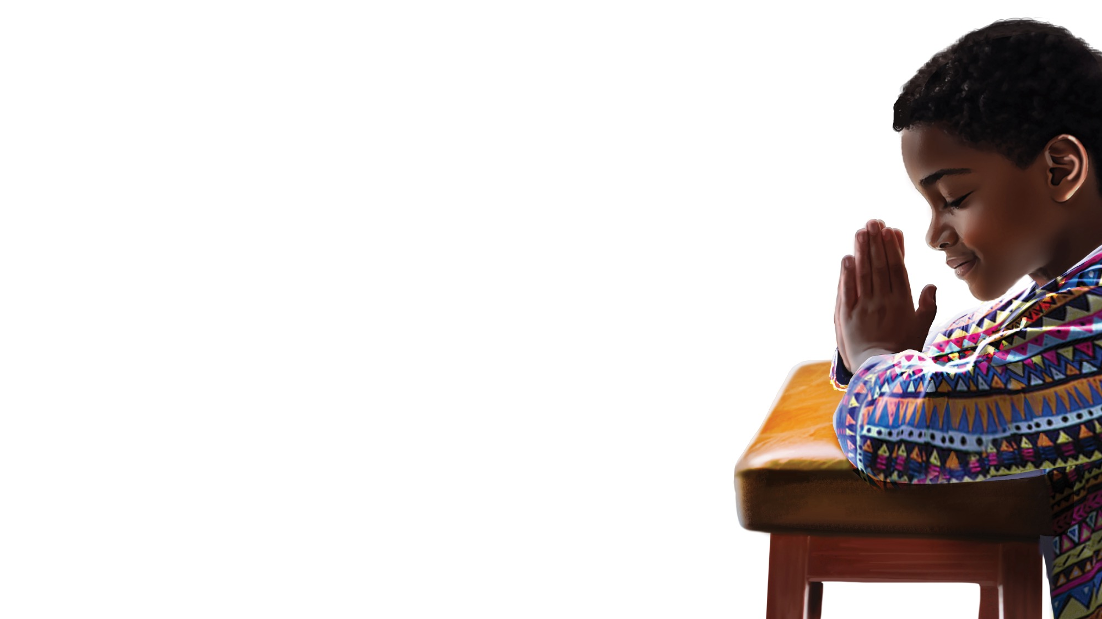
PRAYER
PRAYER

Slide 11
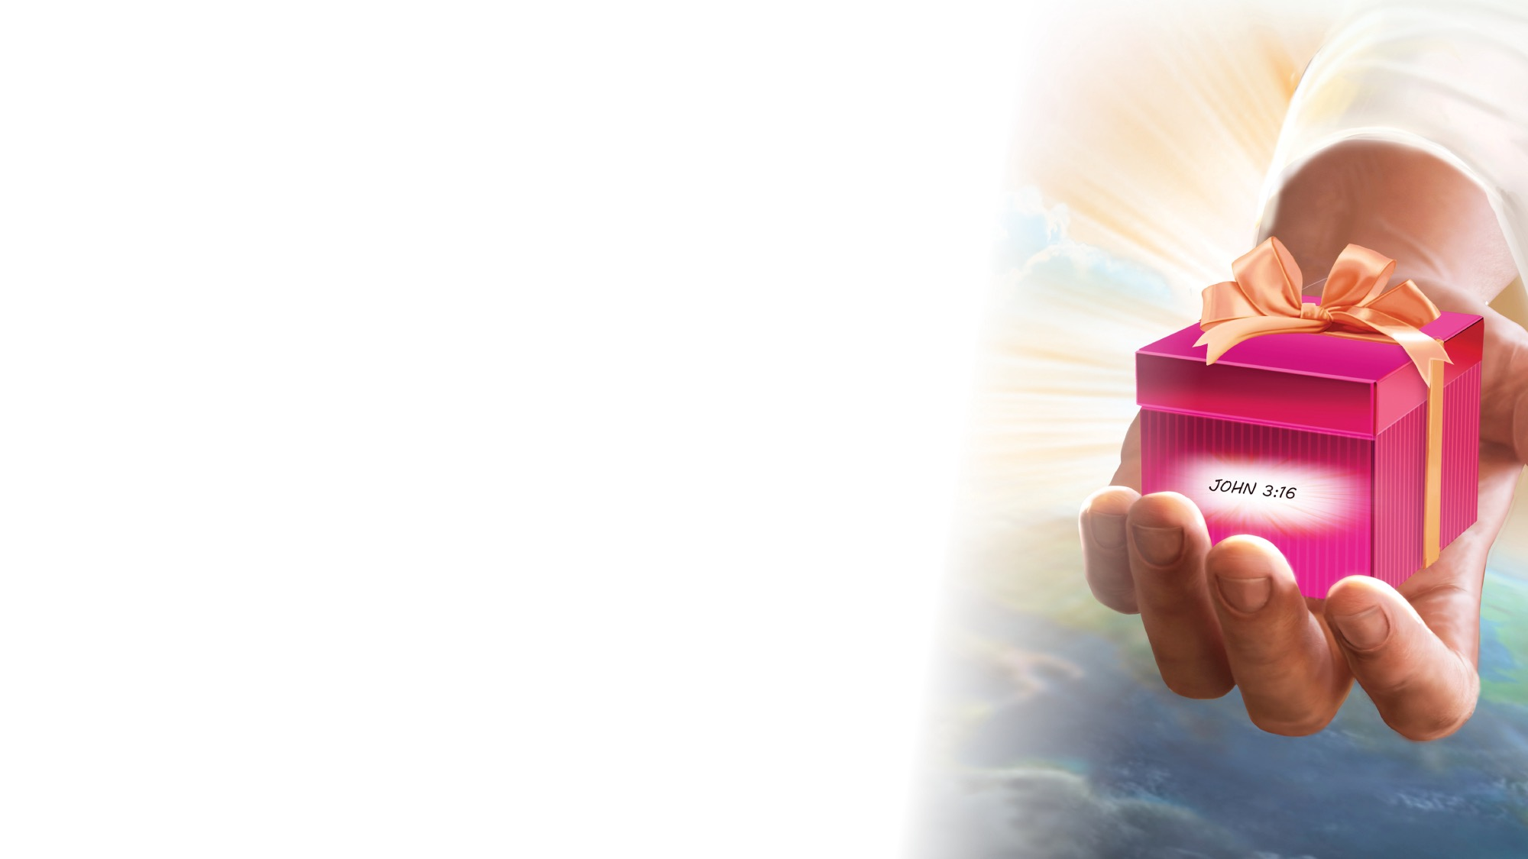
OFFERING

Slide 12

Thank You, Jesus
OPENING ACTIVITIES
Thank you, Jesus
For providing all my needs.
I want to give a little back
Of what you’ve given me.
Please bless our
Sabbath School offering.
May it bring You glory
And help others in need.
(Repeat above)
May it bring You glory
And help others in need.
"Thank You, Jesus" by Rosie Smith, copyright © 2024 General Conference Corporation® of Seventh-day Adventists.

Slide 13
MISSION
FAST FACT &
OFFERING
CHART

Slide 14
Visitor Song
OPENING ACTIVITIES
We have a new friend
With us today.
We have a new friend.
Let’s smile and wave.
We welcome you to Sabbath School.
We’re glad you came.
We welcome you,
And hope to see you again. (x2)
“Visitor Song” by Rosie Smith. Copyright © 2025 General Conference Corporation® of Seventh-day Adventists.

Slide 15
Happy Birthday
OPENING ACTIVITIES
Happy birthday, happy birthday,
Happy birthday to you.
Jesus loves you dear ___________.
Happy birthday to you.
(Repeat above)
“Happy Birthday” by Janet Sage, copyright © 2001 North American Division Corporation of Seventh-day Adventists. From Little Voices Praise Him, #39. Used by permission.

Slide 16

FOCUS
ACTIVITIES

Slide 17

BIBLE
STORY

Slide 18
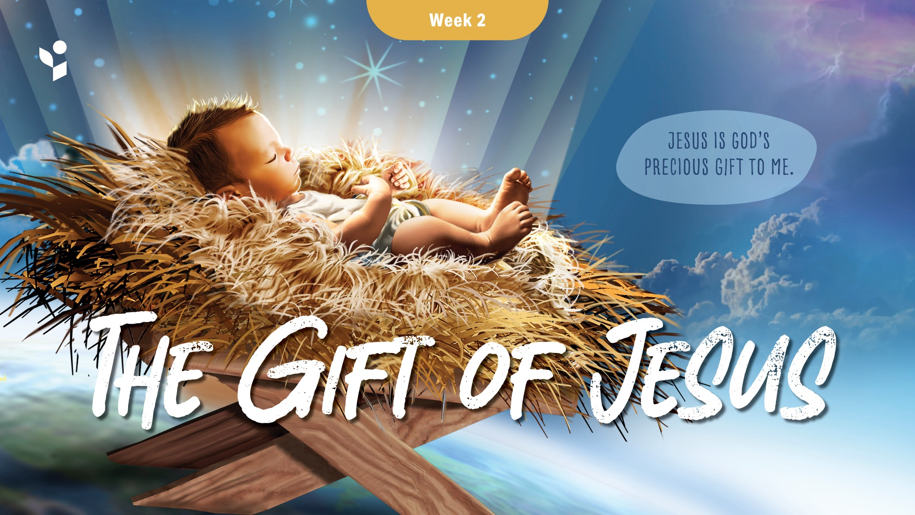

Slide 19
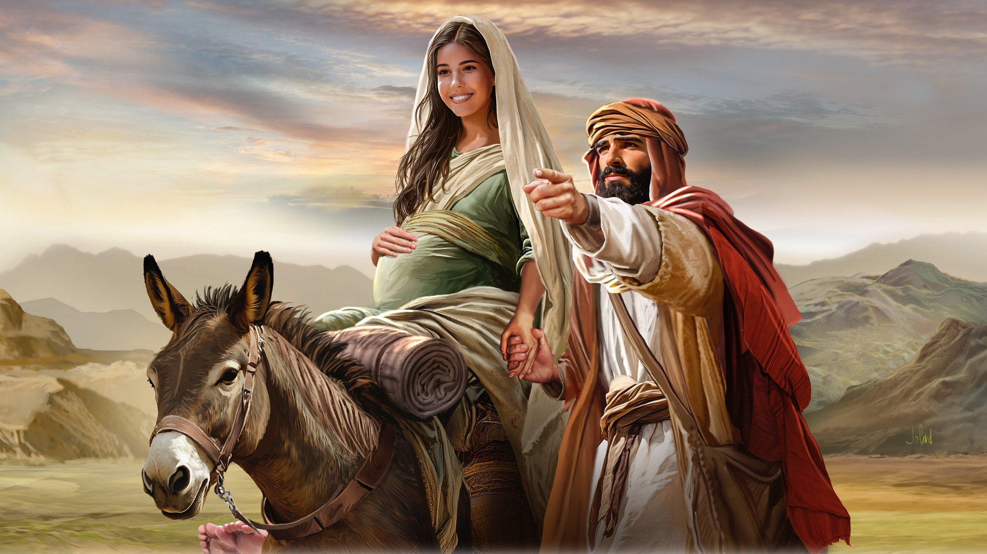
Illustration by Jo Card. Copyright © 2024 General Conference Corporation® of Seventh-day Adventists.

Slide 20
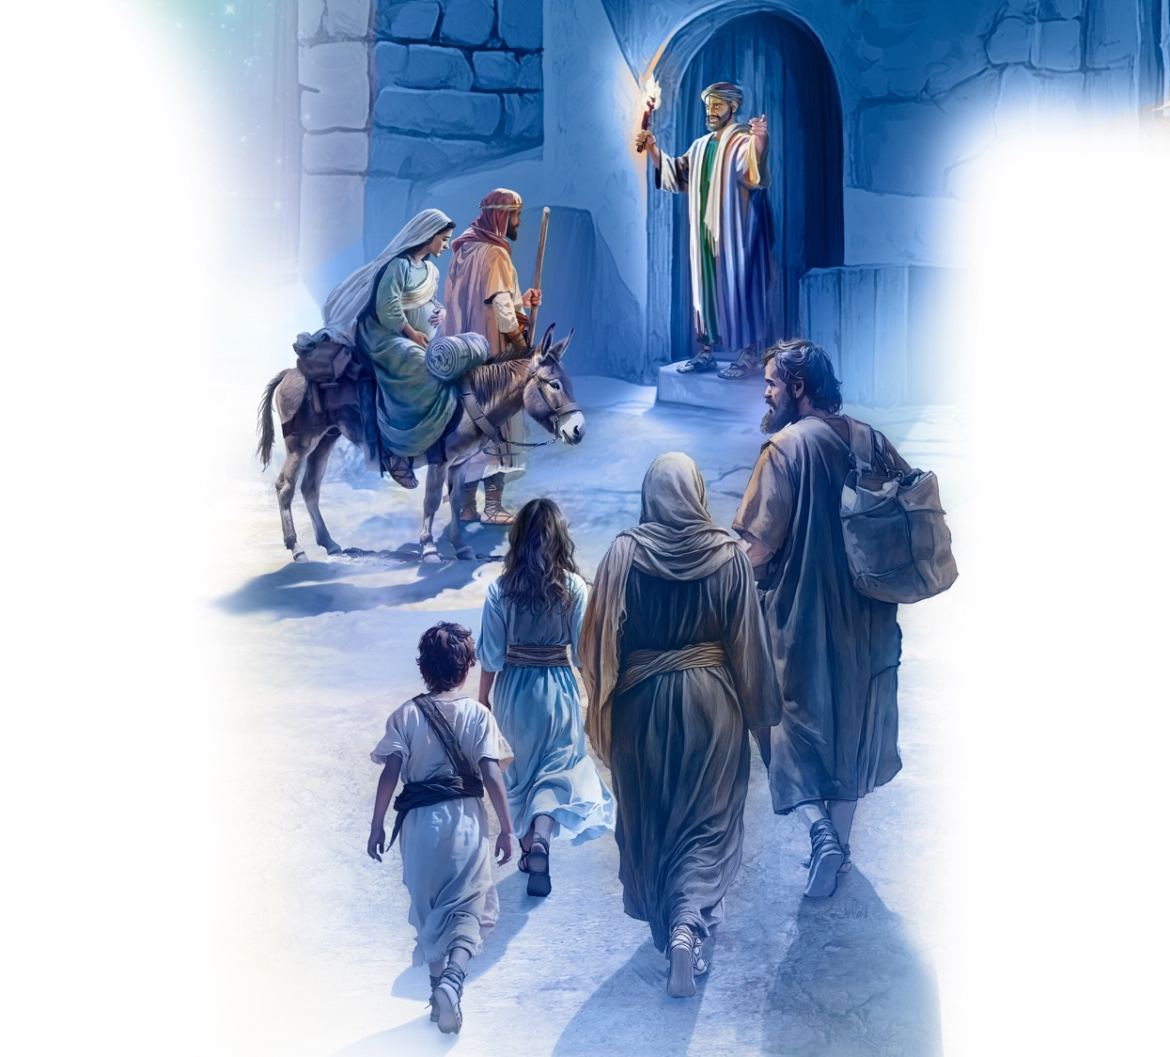
Illustration by Jo Card. Copyright © 2024 General Conference Corporation® of Seventh-day Adventists.

Slide 21
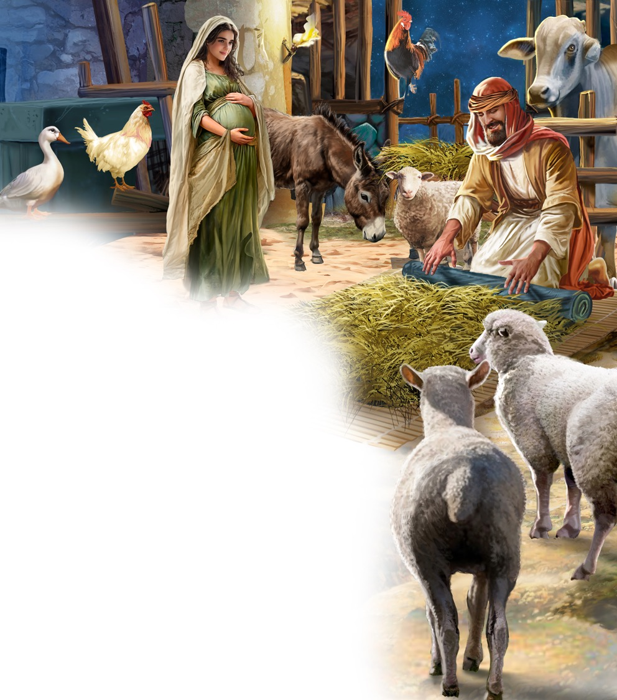
Illustration by Jo Card. Copyright © 2024 General Conference Corporation® of Seventh-day Adventists.

Slide 22
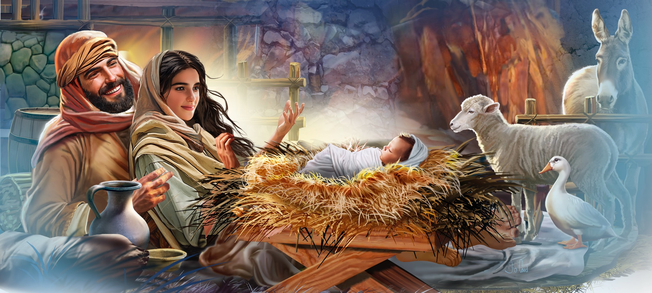
Illustration by Jo Card. Copyright © 2024 General Conference Corporation® of Seventh-day Adventists.

Slide 23
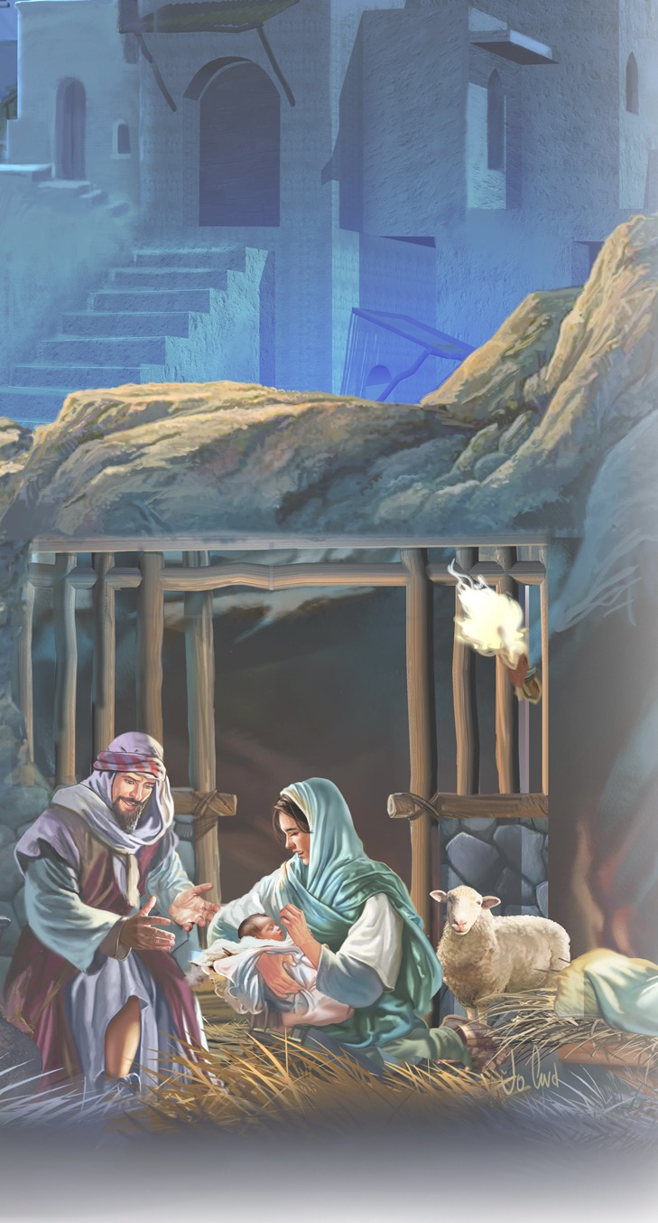
Silent Night (acapella)
BIBLE STORY
Silent night, holy night,
All is calm, all is bright,
Round yon virgin, mother and child,
Holy infant so tender and mild.
Sleep in heavenly peace,
Sleep in heavenly peace.

Slide 24
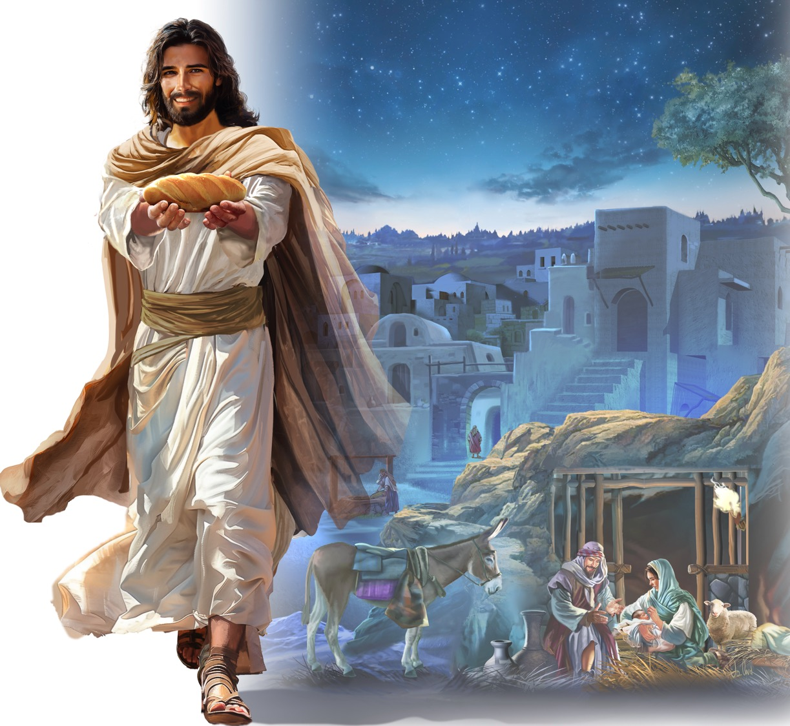
Illustration by Jo Card. Copyright © 2024 General Conference Corporation® of Seventh-day Adventists.

Slide 25
Away in a Manger (acapella)
BIBLE STORY
Away in a manger,
No crib for a bed,
The little Lord Jesus
Lay down His sweet head.
The stars in the night sky
Looked down where He lay,
The little Lord Jesus,
Asleep on the hay.

Slide 26
UNPACK
THE STORY

Slide 27
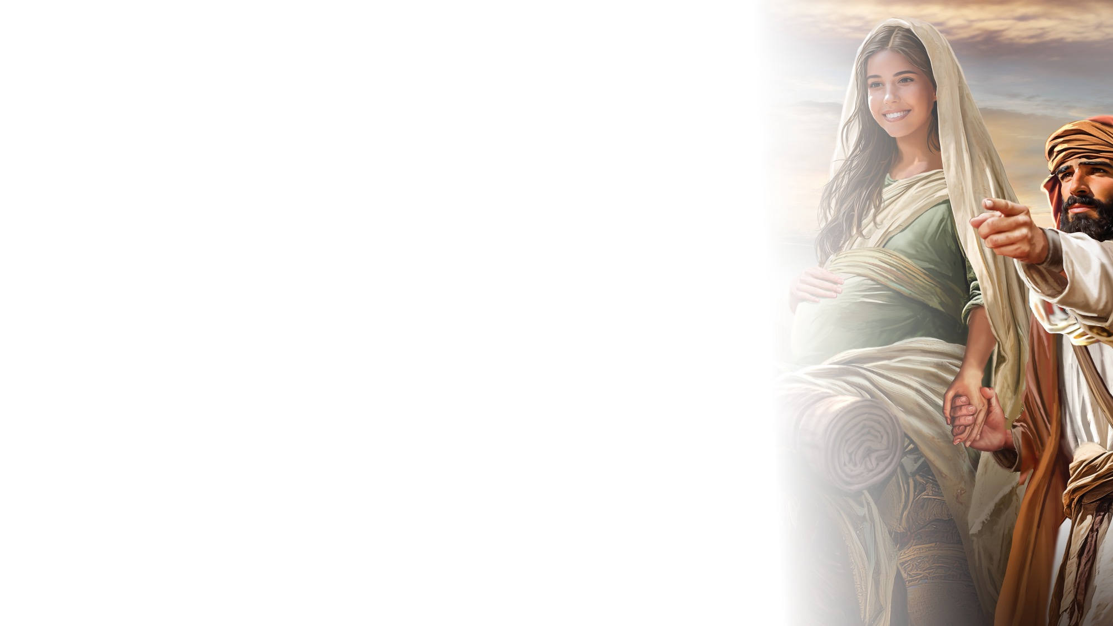
BIG IDEA
Jesus is God’s precious gift to me.

Slide 28

CHARACTER CARDS

Slide 29
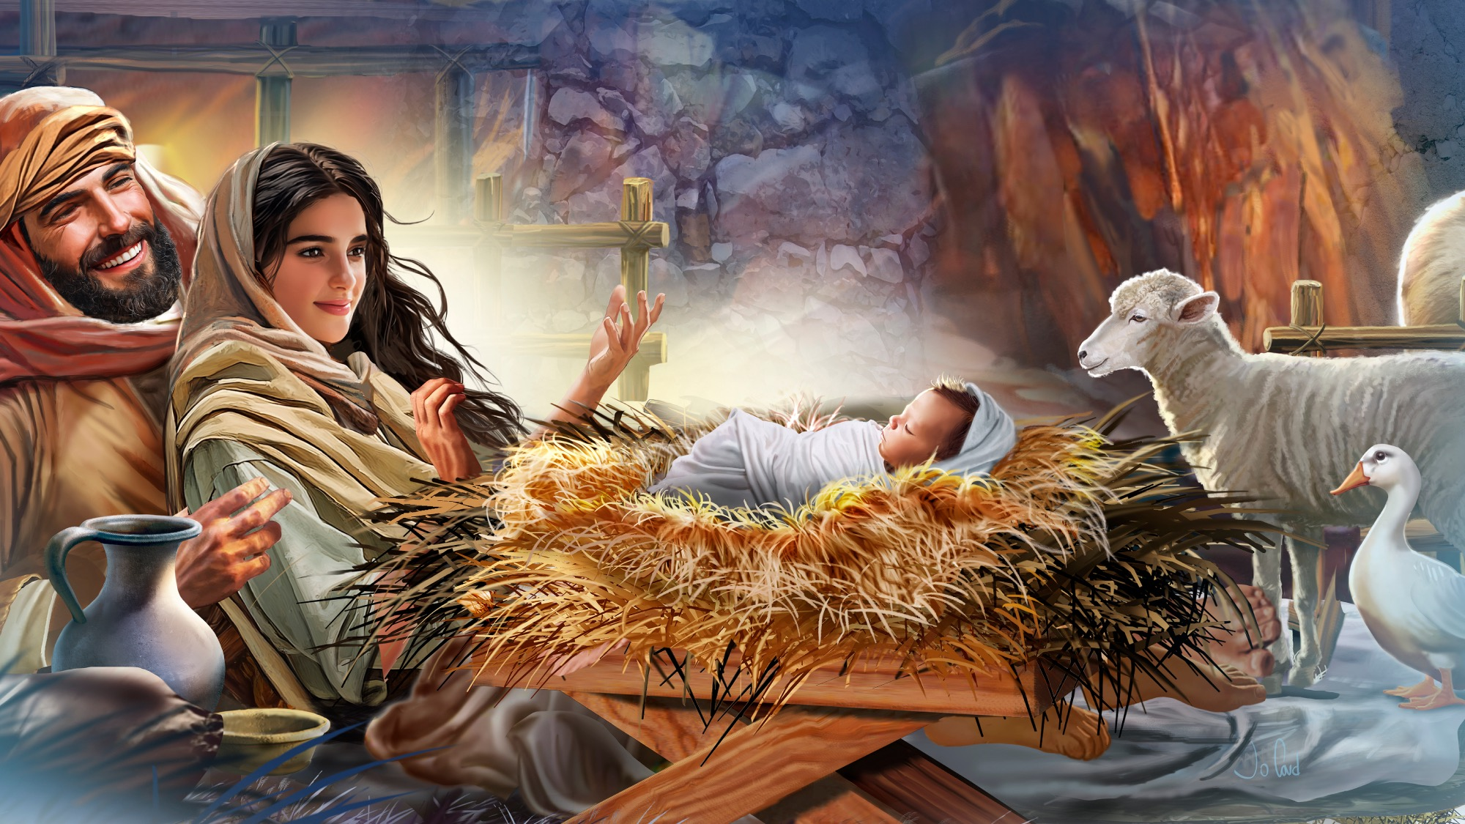
MEMORY VERSE
“For God so loved the world that He gave His only begotten Son, that whoever believes in Him should not perish but have everlasting life.”
John 3:16

Slide 30
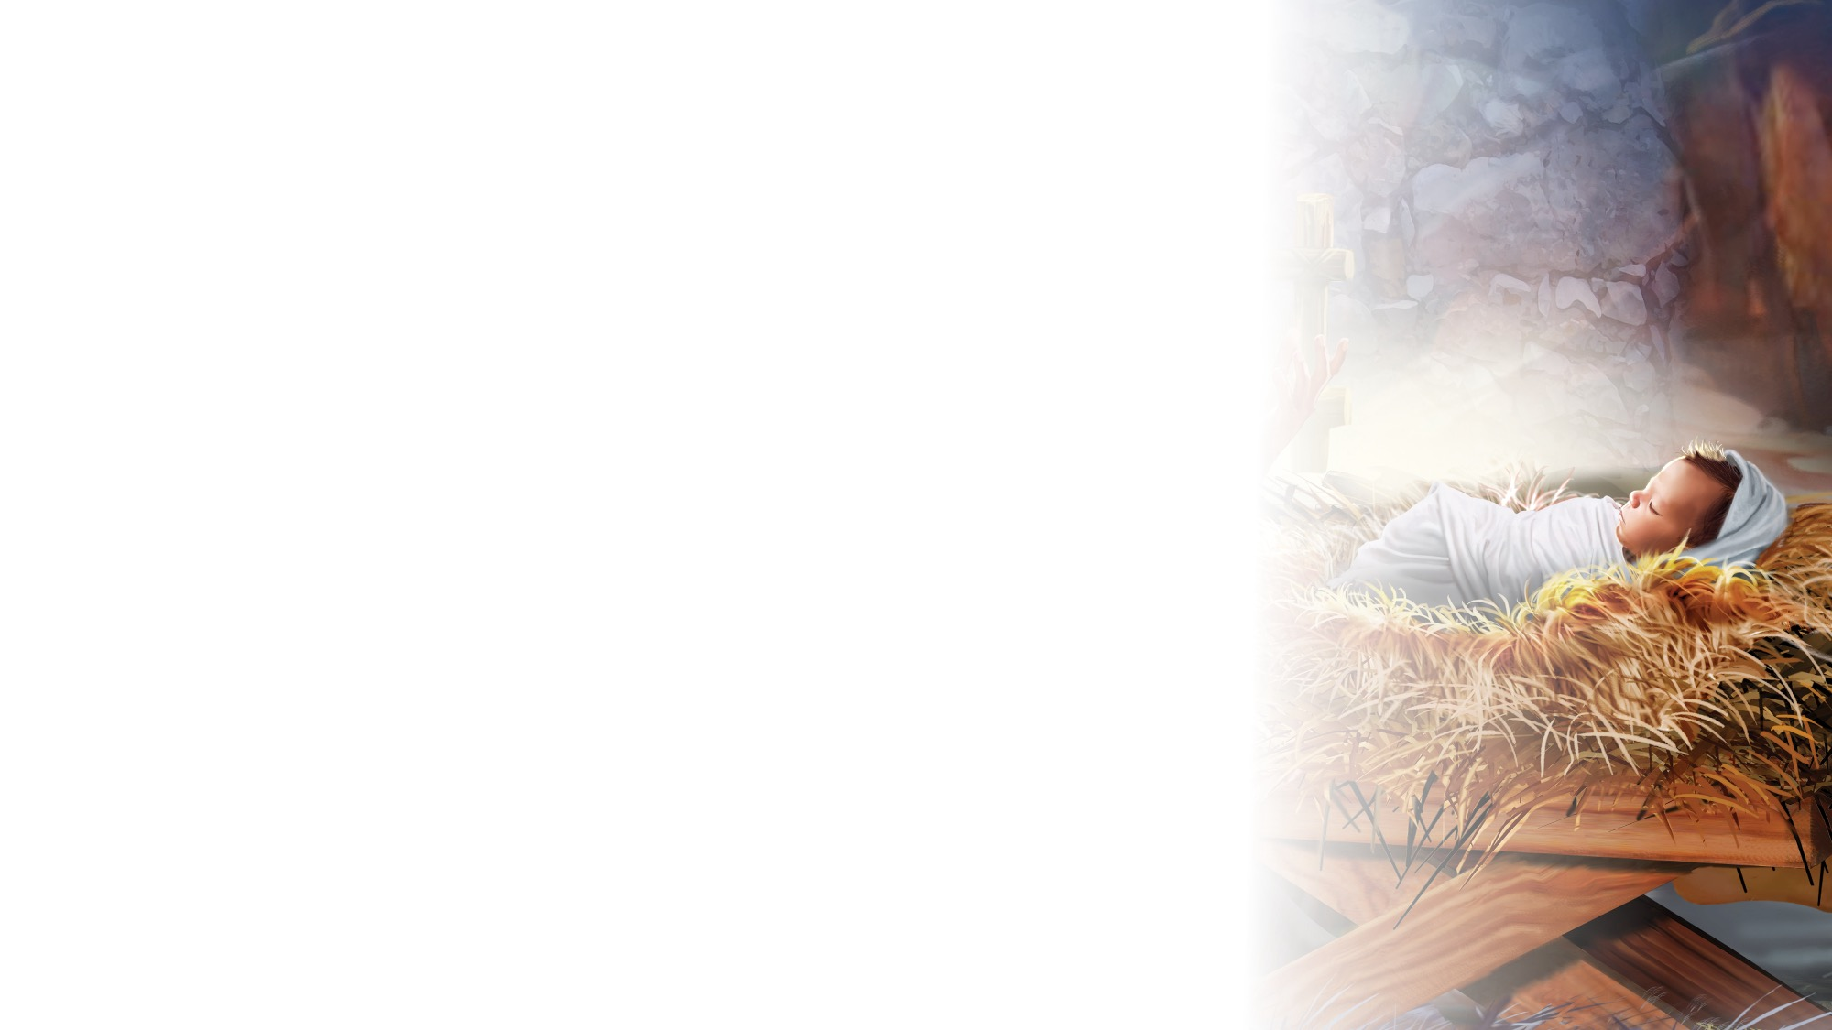
John 3:16
SCRIPTURE SONG
For God so loved the world
That He gave His only begotten Son,
That whoever believes in Him
Should not perish
But have everlasting life.
John 3 verse 16.
(Repeat)
"John 3:16" music by Rosie Smith, copyright © 2026 General Conference Corporation® of Seventh-day Adventists.

Slide 31
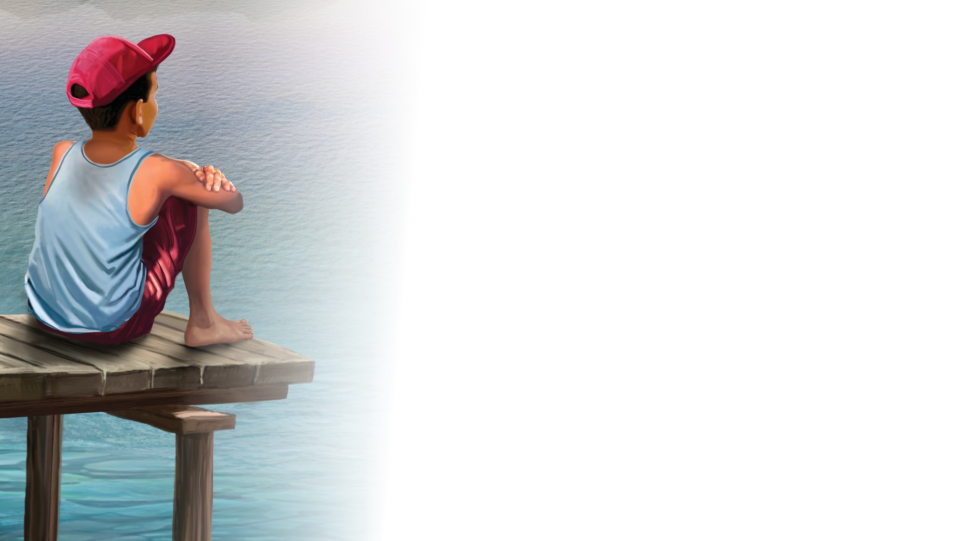
NATURE
LESSON

Slide 32

CRAFT

Slide 33
BIG IDEA
Jesus is God’s precious gift to me.

Slide 34

MISSION
CHALLENGE

Slide 35

PRAYER
RESPOND & PRAY

Slide 36

God Bless You
CLOSING SONG
What did you enjoy today?
What did you learn that’s new?
It’s time for us to say,
“Goodbye and see you soon.”
(Repeat above)
We’ll see you again,
So until then,
God bless you.
(Repeat above)
God bless … you!
"God Bless You" by Rosie Smith, copyright © 2025 General Corporation® of Seventh-day Adventists.

